Slide 1

Team Details
Team Name: Uttarakhand(phadi)UK
Team Leader Name: Ayush Kathait
Problem Statement: Turning agri-waste into profitable business opportunities

Slide 2
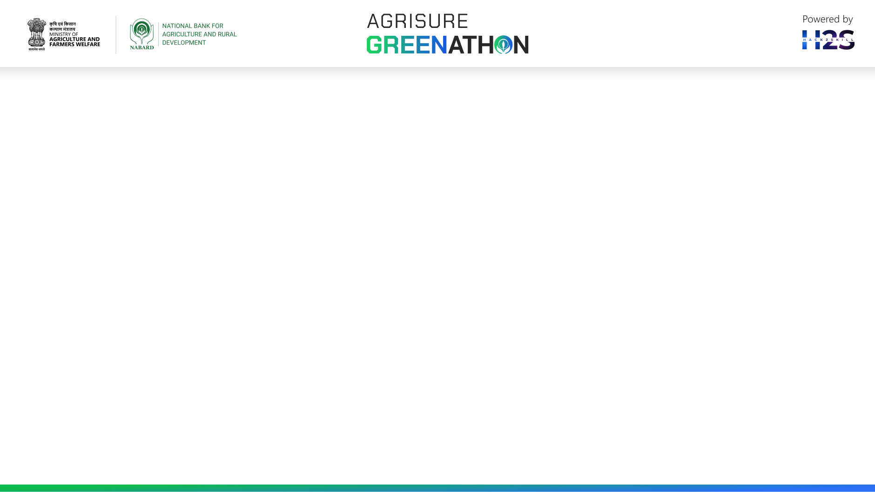
Brief about the idea – Utilises agricultural products to convert into high value products
Unique selling proposition examples -; Renewable energy, organic farming ,and green packaging . , organic fertilizers ,biodegradble packaging solutions. Etc…..

Slide 3
Opportunities
How different is it from any of the other existing ideas?
How will it be able to solve the problem?
USP of the proposed solution
Ans1;- This idea helps to improve the farmer income and turn agri waste into profitable income
Ans2;- Agri waste can solve environmental issues by reducing pollution and green house gas emissions. When agriculture waste is left to decompose into fields or landfills, it can release harmful gases like methane, contributing to climate change .by effectively managing agri waste through recycling, composting,or conversion into biofuels , we can mitigate these environmental impacts. leading to the more sustainable and eco-friendly approach to agriculture and waste management.
Ans3;- By repurposing agri waste through innovatie methods like biofuel production, composition , or biodegrable packaging, businesses can showcase their commitment to environmental.

Slide 4
List of features offered by the solution – India produces more than 620 million tonnes of agricultural waste annually, of which only 25-30 percentage is utilised as livestock fodder and energy production.
Waste management approaches;-
1- Disposal of agriculture waste
2- Recycling of agriculture waste or by-product
Innovative technologies are being used to convert this waste into wealth- the use of post-harvest waste from fields, waste from piciculture, horticulture, insect faring etc are also can be used – Industries that convert waste into wealth-
1-Handmade paper from jute waste
2-Preparation of protein isolates and concentrates from de-oiled cakes production
3-Production of enzymes like cellulases by microbial fermentation utilizing groundnut shell

Slide 5
4-Production of biocompost and organic manure 5- Making paper plates from natural fibre biomass 6-Essential oil extraction from crop residues of seed spices 7-Production calcium,collagen peptide and gelatin from fish waste 8-Producing alcoholic beverage with nutraceutical properties from kinnow peels 9-Isolation of antioxidants,pectin and dietary fibre from mango peel 10-Making porous bricks from crop residue etc….

Slide 6
Another examples agri waste into profitable business opportunity- 1-By creating organic fertilizers 2- crop residue, manure ,and leftover plant material can be composted into high-quality organic fertilizers 3-Production of biofules 4-agri waste like crop residue,straw, and sugarcane bagasse can converted into biofules like bioethanol , and biodiesel 5- we can convert agri waste into vermicompost ex- fruit and vegetable peel

Slide 7
Technologies to be used in the solution
1-Biomass gasification – we can convert agri waste into synthesis gas that can be used for heat ,electricity generation, or biofules production
2-Anarobic digestion which breaks down organic material in agri waste to produce biogas that can used for energy production
3- Pyrolysis offers a sustainable way to utilize agri waste and create valuable products for various application .
4-we can also create biopesticide by diifrent types of agri waste ex- neem oil +soap solution

Slide 8
Process flow
1-Agri waste collection- gather various types of agri waste such as crop residues , animal manure,and food processing by products.
2-segregation and sorting- Seprate different types of agri waste to ensure proper handling and processing based on their characteristics
3-Processing and treatment –(a)-biofuel production-; convert organic waste materials into biofuels through processes like anaerobic digestion or bioethanol production. (b}-composting-Decompose organic waste to create nutrient rich compost for agriculture use (c)-biodegradable packaging production-; Transform agri waste into Biodegradable packaging materials through appropriate processing techniques.
4-Quality control- Ensure the quality and standards of the end products meet market requirement and regulations

Slide 9
5-Market research and development [a]-Identify potential markets and customers for the products derived from agri waste (b)-Develop marketing strategies highlighting the enviromrntal benefit and unique features of the products.
6-Sales and distribution-(a)-Establish sales channels to distribute biofuels, compost, or biodegradable packaging to consumers (b)-Explore partnerships withy retailers, wholesalers, or online platforms for product distribution
7-Monitoring and Evaluation (a)- track production processes, costs, and revenues to assess the profitability of the business (b)-Continuously improve operations based on feedback and market trends
By following these steps in the process flow diagram , a business can effectively convert agri waste into profitable venture while contributing to sustainability and environmental conservation

Slide 10
Estimated implementation cost (optional)
1-Equipment and infrastructure
2-Raw material acquisition
3-Labour cost
4-Marketing and promotion
5-Regulatory compliance
6- Miscellaneous expenses

Slide 11
Additional Details/Future Developments
I apologize if any mistake I have done in this ppt hope it will help to give knowledge to farmers and other small and marginal farmers . Btw I am from agri background we don’t have more technical knowledge on projects etc . This is my first online project I want to be nabard grade a officer in future and want to help rural people and make rural area better . currently I am 19 years old
Thank you

Slide 12
GitHub Public Repository Link & Demo Video Link
AgriSURE_Greenathon___Idea_Submission_Template[1].pptx

Slide 13


